Slide 1
Interviewing Skills

Slide 2
What is an interview
An interview is a conversation between the employer and the potential candidate, for both to learn more about each other and about the vacancy on hand.
Both parties have a need: you want a job and the employer wants to find the right person to fill the job.
Interviews are your opportunity to make a lasting and positive impression while differentiating yourself from others.

Slide 3
What is an interviewer seeking
Three main areas employers look at in the selection process:
What can you do for us? This can be demonstrated through your educational background, prior experience, special skills and knowledge.
Why do you want to work with us? As a candidate you should understand the company’s goal before applying, and if it fits your long term –as well as your short term goals, then go for it and be sure you’ll be one of the team soon.
What are you like once we’ve gotten to know you? Employers are looking at areas such as your motivation, creativity, problem-solving abilities, and team work skills, and how these skills will continue once you are hired.

Slide 4
What is a candidate seeking
Many candidates have a false idea that the interviews are only one-way process.
You can use the same criteria as the employer to get a better understanding of the position and about the organization.
What can you do for me? Ask about the career path, and how can you develop.
Why do I want to work for you? Will working in this organization/industry fit my short-term/ long-term goals?
What are you like once I have gotten to know you? Make sure that the working environment is suitable for you, as you’ll spend minimum of 8 hrs/day working in the company.

Slide 5
Types of Interviews
Stress Interviews:
A stress interview is an interview in which the interviewer tries to discomfort the candidate in different ways by observing how he reacts to different situations.
It is considered as a test of the candidate’s behavior, logic and emotional control under pressure.

Slide 6
Why stress interviews?
This interview is an attempt to see how the candidates handle themselves under stress. So, the interviewer deliberately assumes a sarcastic or argumentative position. The trick for the interviewee to remain calm under such a situation.

Slide 7
One-on-One Interview:
This is the most common type of interviews.
You’ll be interviewed by one person.
During the interview, you should focus on the questions asked, maintain eye contact, and show that your qualifications will benefit the organization.

Slide 8
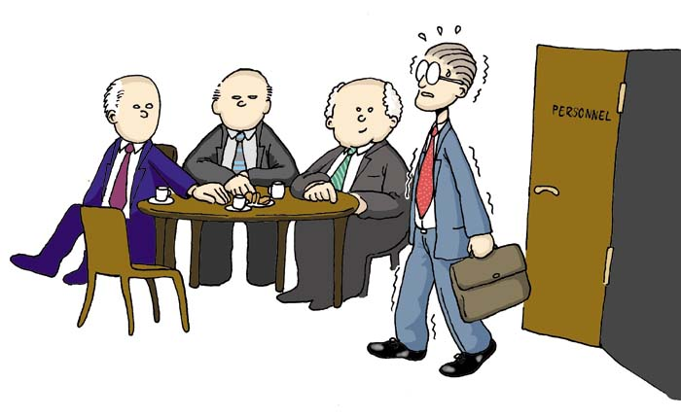
Panel interview:
It consist of more than one interviewer.
To succeed, you should maintain eye contact with the person who asks the question, yet you should be looking to each one of them.

Slide 9

Group interview:
it consists of one interviewer and a group of candidates.
This type is mainly used to discover how you can deal under-pressure, how you can deal with different types of people surrounding you, test your communication skills and your leadership skills.
Also to see how you interact with others and how you use your knowledge and skills to influence them.

Slide 10
Why group interviews?
Group interview is also the best way to discover any leadership potential among the candidates.
The leading candidates who are selected from the group interview are then taken for an informal one to one interview.

Slide 11

Group-Panel interview:
it consists of a group of interviewers and a group of candidates.
As one of the interviewers ask questions, the other will be closely monitoring the groups’ reaction to these questions.
You should focus with each one of them, and also focus with the group of candidates surrounding you.

Slide 12
Phone Interview
Phone interviews are increasingly used in mass hiring.
The interview is conducted entirely over the phone and this is very effective in eliminating any bias that may arise from the appearance and manner of the candidate.

Slide 13
Why the phone interview?
Phone interview is used to narrow a field of candidates. That is why candidates should treat this interview with the same seriousness as a phone interview.
The candidate should focus on the conversation and listen to the questions carefully before answering. In this interview, voice is also a key.

Slide 14
Job interviews strategies
Job interview strategies that focus only on the interview is not enough.
You must use strategies that cover the entire process. They can be divided into three phases:
Actions you should take before the interview.
Actions you should take during the interview.
Actions you should take after the interview.

Slide 15
Pre-interview Strategies
Research the company.
Study the job description carefully and make sure your CV is suitable for what the company is looking for.
Prepare for questions that will be asked during the interview.
Prepare questions you will ask during the interview.
Visit the interview location a day or so before your interview.
Plan what to wear to your interview.
Take good care of your nutrition.

Slide 16
During-interview Strategies
Job interviews can be intimidating and unpleasant, but only if you are unprepared.
Because you followed the Pre-interview Strategies, you will be more confident, professional, and less nervous than the other candidates.
During your job interviews, you will be enthusiastic, likeable, determined, and knowledgeable.
These traits are all more important than your job qualifications. As most of the employers hire for personality and train for skills.

Slide 17
During-interview Strategies
Arrive early.
Make your introduction and greeting memorable.
Use body language that shows you are enthusiastic, confident, and comfortable with the interview process.
Be yourself, but only up to a point.
Answer questions clearly and confidently.
After answering their questions, ask some yourself.
Exit gracefully.

Slide 18
Tips on how to stay calm in the interview
Don’t be negative.
The more realistic you are, the better.
Don’t provoke aggression or create conflict.
Behave normally.
Maintain eye contact, and keep your answers short in order not to get interrupted.
If the interviewer stresses you purposely, slow down and try to speak as calmly and softly as you can.

Slide 19
Tips on how to stay calm in the interview
Remember it’s not the interviewer’s question that is important but the quality of your answers. Therefore take a breath and focus on the question.
Sometimes questions don’t have a correct or wrong answer. Remember that the interviewer might just want to see how you are dealing with the situation.
Don’t look too serious or irritated at the interviewer. If the interviewer tries to provoke you, you should not erase the smile on your face.
If the interviewer asks you the same question over and over again, then please be clear on what you say and stick to that. Don’t change your answers.

Slide 20
Post-interview Strategies
Send a Thank-You e-mail.
Don't be shy about making follow-up calls.
DONT worry, BE happy.
If you got the job, go celebrate! If you didn't, don't despair, just start again.

